Slide 1
CEDB 1260
Big Data Analytics
A regression model to predict on-time, delayed and canceled, flights
by Arwa Sheraky & Tiffany Eversley

Slide 2


Background
Problem: With flight information being readily available online, certain factors such as airline carrier, airport location, and/or historical delay and cancellation details, may be expected to increasingly influence passenger travel decisions.
Our goal is to predict average delay times based on select attributing factors

Slide 3

Dataset
This 2015 dataset summarizes US airline flight delay and cancellation information as collected and published by the DOT's Bureau of Transportation Statistic.
Attributes: Drawing airport and airline information from two additional datasets helped expand the original source file by pulling from, and merging , relevant attributes. The dataset is now characterized by 28 representative features and includes over a million instances. Features include airport origin, time of the flight (YMD), actual and scheduled departure times, arrival times, flight number, as well as cancellation and delay reason.

Slide 4
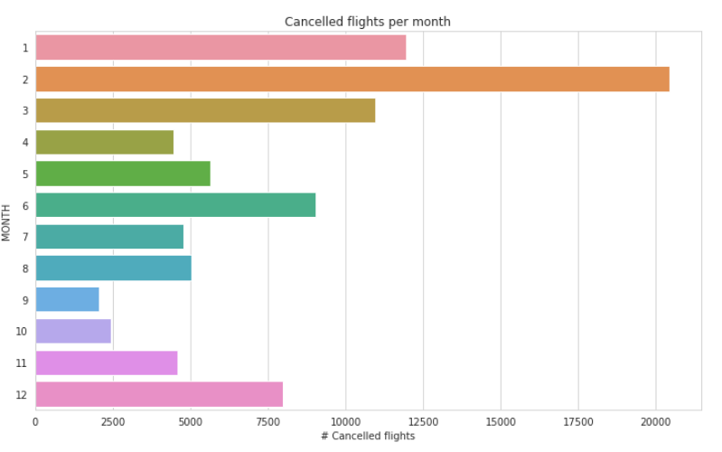
Approach
Data Cleaning & Visualization : Outliers were removed, missing values filled in, columns renamed, duplicates and unused columns removed and datasets were merged

Slide 5
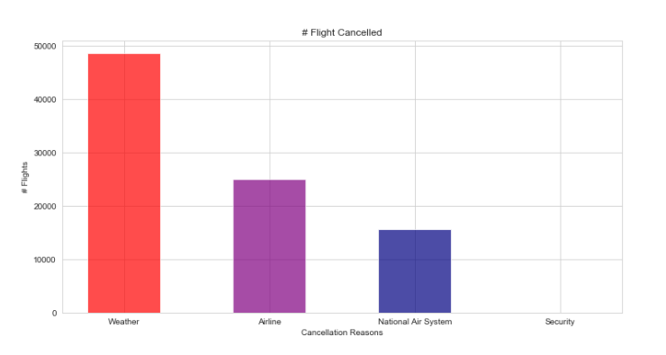
Approach
Data Cleaning & Visualization : Number of flights were plotted against delay reasons to determine top reasons for flight delays and cancellations.

Slide 6
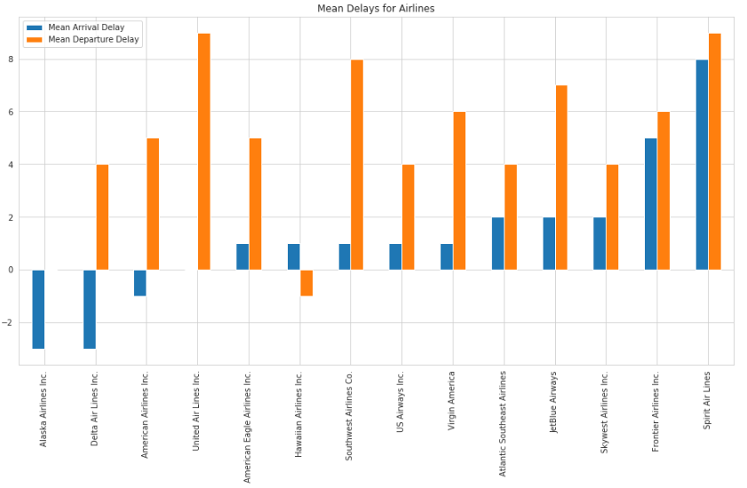
Approach
Data Cleaning & Visualization : Average departure and arrival delays were plotted per airline to determine those that contributed the highest to the mean.

Slide 7

Results
Regression Model: A regression model was chosen to predict average delay time based on size of the dataset and desired output values.

Slide 8
Results
Regression Model: A regression model was chosen to predict average delay time based on size of the dataset and desired output values.

Slide 9

Next Steps

